Slide 1
Web Engineering
Ms Nabeela Bibi

Slide 2

What is Web Hosting?
Web hosting is a service that allows organizations and individuals to post a website or web page on to the Internet.
A web host, or web hosting service provider, is a business that provides the technologies and services needed for the website or webpage to be viewed in the Internet. Websites are hosted, or stored, on special computers called servers.

Slide 3
Why Web Hosting Matters:
Website Accessibility: Web hosting ensures that your website is available 24/7, allowing users to visit it at any time from anywhere in the world.
Performance: The quality of your hosting affects your website's speed and performance. A reliable host contributes to faster loading times, which is essential for user satisfaction and SEO.
Data Storage: Hosting providers allocate server space for storing website files, databases, and other content, ensuring that everything is securely stored and accessible.
Scalability: As your website grows, a good hosting service should offer scalability options to accommodate increased traffic and resource demands.
Security: Hosting providers implement security measures to protect your website from online threats, including malware and hacking attempts.
Technical Support: Many hosting services offer technical support to assist with server-related issues, ensuring that your website remains operational.

Slide 4
Types of Web Hosting
Shared Hosting
VPS Hosting
Dedicated Hosting
Cloud Hosting
Managed Hosting
WordPress Hosting

Slide 5
Types of Web Hosting
Shared Hosting:
Shared hosting is a common and cost-effective hosting option where multiple websites share resources on the same server.
While it's budget-friendly, it also means that server resources, such as CPU, RAM, and bandwidth, are shared among users.
This can be a great choice for personal blogs and small websites with moderate traffic.

Slide 6
Types of Web Hosting
Virtual Private Server (VPS) Hosting:
VPS hosting offers a dedicated virtual server within a shared environment.
It provides more control and resources compared to shared hosting.
Each VPS operates independently, allowing users to configure server settings, install software, and allocate resources as needed.
VPS hosting is suitable for growing websites that need more control and resources without the cost of a dedicated server.

Slide 7
Types of Web Hosting
Dedicated Hosting:
Dedicated hosting involves the allocation of an entire server to a single user or organization.
With dedicated servers, you have full control over server resources, configurations, and security.
This option is ideal for high-traffic websites, e-commerce stores, and applications that demand top-tier performance, security, and customization.

Slide 8
Types of Web Hosting
Cloud Hosting:
Cloud hosting utilizes a network of virtual servers hosted in a distributed cloud infrastructure.
It offers exceptional scalability, flexibility, and redundancy.
Cloud hosting resources can be easily adjusted to accommodate traffic spikes or increased demands, making it suitable for websites with varying traffic patterns or unpredictable growth.

Slide 9
Types of Web Hosting
Managed Hosting:
Managed hosting is a service-oriented hosting solution that includes additional management services.
Hosting providers handle server maintenance, security, updates, and technical support, allowing users to focus on their website's content and functionality.
This option is particularly beneficial for non-technical users or businesses that want a hassle-free hosting experience.

Slide 10
Types of Web Hosting
WordPress Hosting:
WordPress hosting is specialized hosting tailored specifically for WordPress websites.
It's optimized for WordPress performance, security, and ease of use.
WordPress hosting often includes features like automatic updates, pre-installed plugins, and expert support, making it an excellent choice for individuals and businesses using the WordPress content management system (CMS) for their websites or blogs.

Slide 11
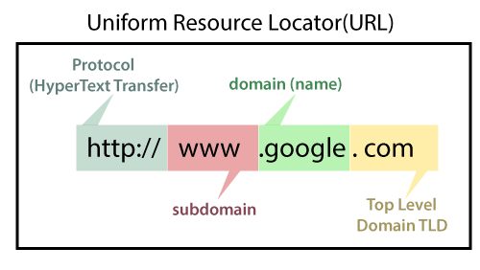
Relationship between domain name and Hosting Service Provider
Domain name:
A domain name is the human-readable address
serves as the identity and online address for your site
To get your website online, you need to connect your domain name to your web hosting service.

Slide 12

Key Hosting Features
Disk Space and Storage:
Sufficient disk space and storage are vital for hosting your website's files and databases.
These files include HTML, CSS, JavaScript, images, videos, and more.
When selecting a hosting plan, consider the size of your website and the amount of data it generates.
Insufficient storage can lead to performance issues and limit your ability to expand your website.

Slide 13

Key Hosting Features
Bandwidth and Data Transfer:
Bandwidth is the amount of data that can be transferred to and from your website within a specific time frame.
It directly impacts the speed and responsiveness of your site.
If your website has high traffic or serves large files (e.g., videos, downloads), you need adequate bandwidth to ensure smooth user experiences.
Insufficient bandwidth can result in slow loading times and potential downtime during traffic spikes.

Slide 14
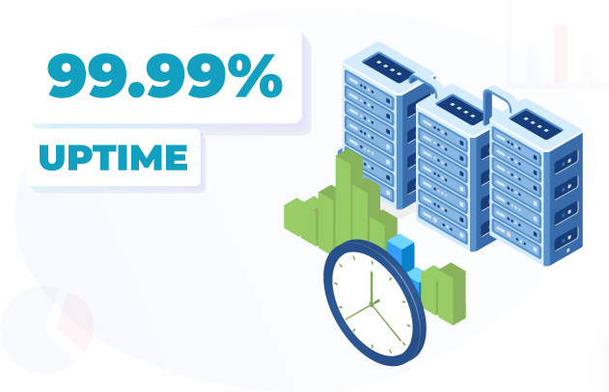
Key Hosting Features
Uptime and Reliability:
Uptime refers to the percentage of time your website is operational and accessible to users.
Hosting providers often offer uptime guarantees, typically measured as a percentage (e.g., 99.9% uptime).
A reliable hosting provider strives to minimize downtime, ensuring that your website remains accessible around the clock.
Consistent uptime is critical for user satisfaction and the success of online businesses.

Slide 15

Key Hosting Features
Scalability
Scalability is the ability to easily adjust your hosting resources to accommodate changes in website traffic and resource demands.
It allows your website to grow seamlessly as traffic increases.
Scalable hosting options, such as cloud hosting and VPS hosting, enable you to allocate additional resources or downgrade when needed, ensuring optimal performance and cost-efficiency.

Slide 16
Key Hosting Features
Security Features:
Security is paramount in web hosting. Hosting providers implement various security measures to protect your website from threats. These measures may include:
Firewalls: Firewalls filter incoming and outgoing traffic, blocking malicious requests and protecting your server.
DDoS Protection: Distributed Denial of Service (DDoS) attacks can disrupt your website's availability. DDoS protection mechanisms detect and mitigate such attacks.
SSL Certificates: SSL (Secure Sockets Layer) certificates encrypt data transmitted between your website and users, ensuring secure connections, especially important for e-commerce and data-sensitive sites.

Slide 17
Being Aware
Here are few things you should ask your perspective provider:
Does it provide enough disk space?
Do they have 24/7 technical support?
What hardware are they using?
Is there user interface for you?
Does it offer mail?
Can it flex?
How much does it cost?

Slide 18


